Slide 1


Final project – Introduction to optical ingeenireing (83922)
Presenting:
  Elisha Gur
  Assaf Shahino
With collabaration of DSR lab by Dr. Igal Levin

Slide 2
Agenda
Introduction
System description
Main Challenge
Theoretical Background and calculations
Errors approximation and implications
calibration methods
code V
Conclusions

Slide 3

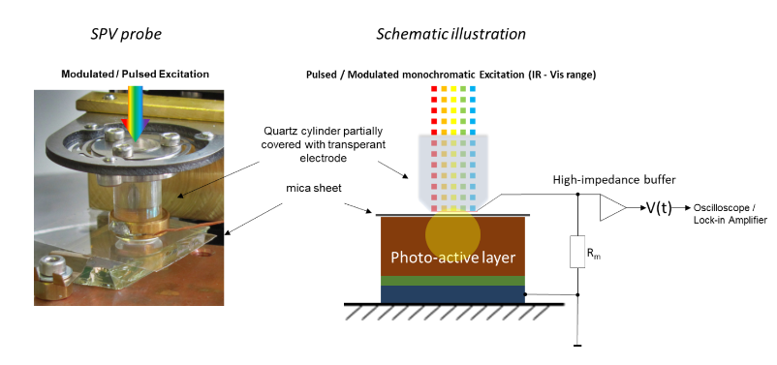
Introduction
The the setup we work on is for measuring SPV ( surface photo-voltage)
We want to direct a laser beam on a patterned material.
Using prims instead mirrors comes from the intensity of the laser beam
Notes:
The the setup we work on is for measuring SPV ( surface photo-voltage)
We want to direct a laser beam on a patterned material.
Due to special limitations we are using 2 right angle prisms

Slide 4
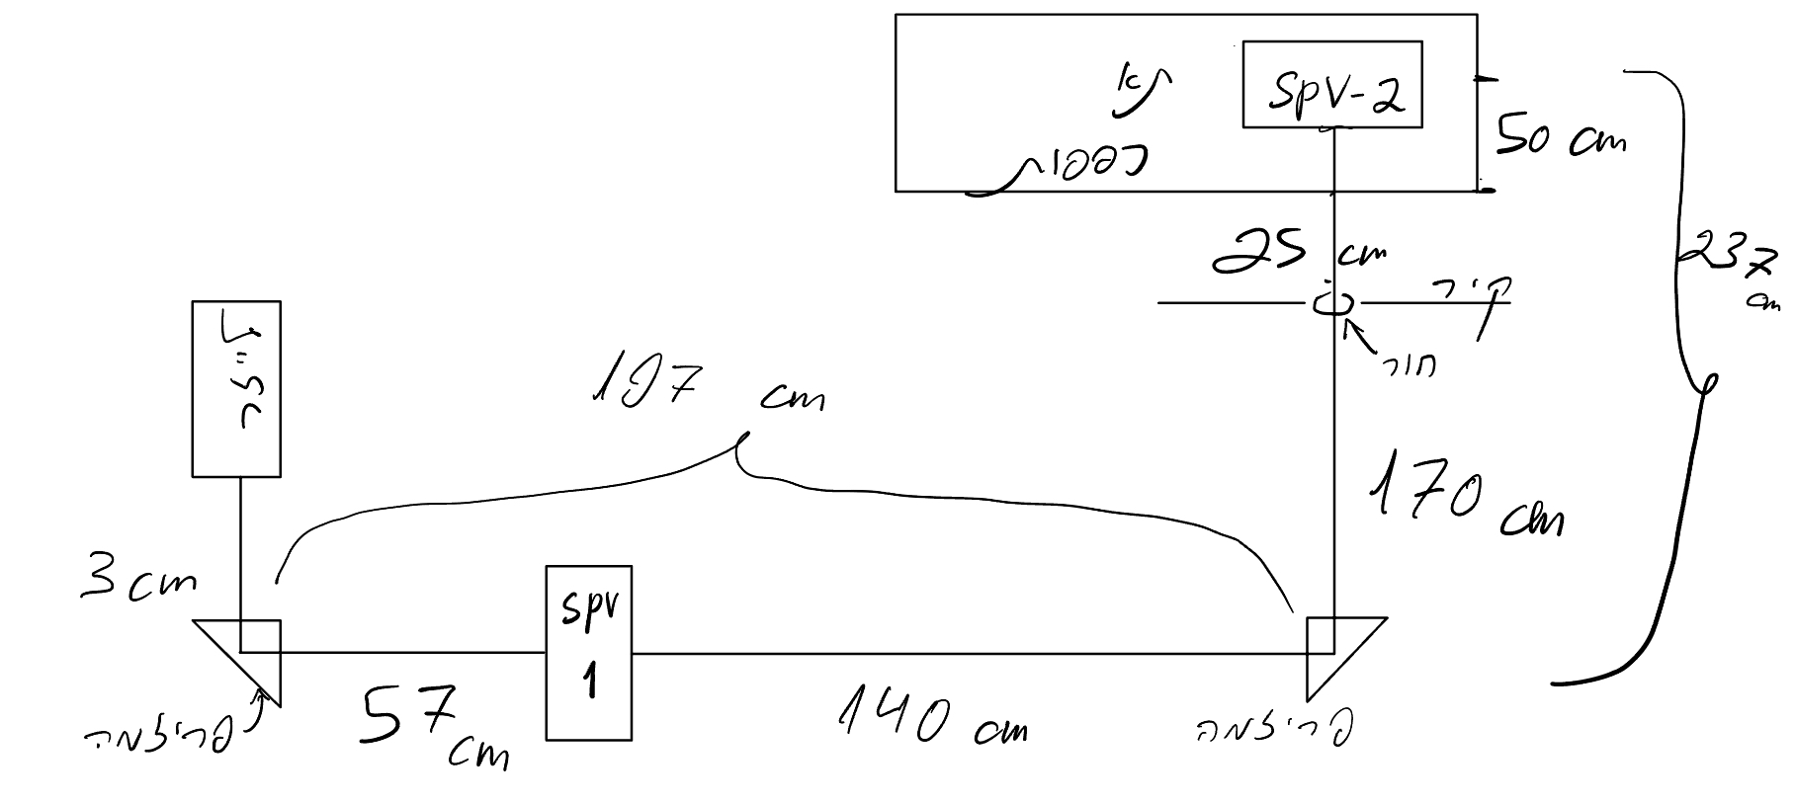
System description
wavelength specturm:
192 – 2600 [nm]
Initial beam diameter:
5 [mm]
Typical divergence angle:
< 2 [mrad]
Total path length:
4370 ± 100 mm
Max beam diameter at image surface:
20 mm
Prism type:
UV fused Silica right angle prism
L = 20
Thorlab

Slide 5
Main Challenge
Large chromatic aberrations – working with refractive optics at Broad wavelength spectrum
Long optical path - high angle sensitivity
Image of the labs distances

Slide 6
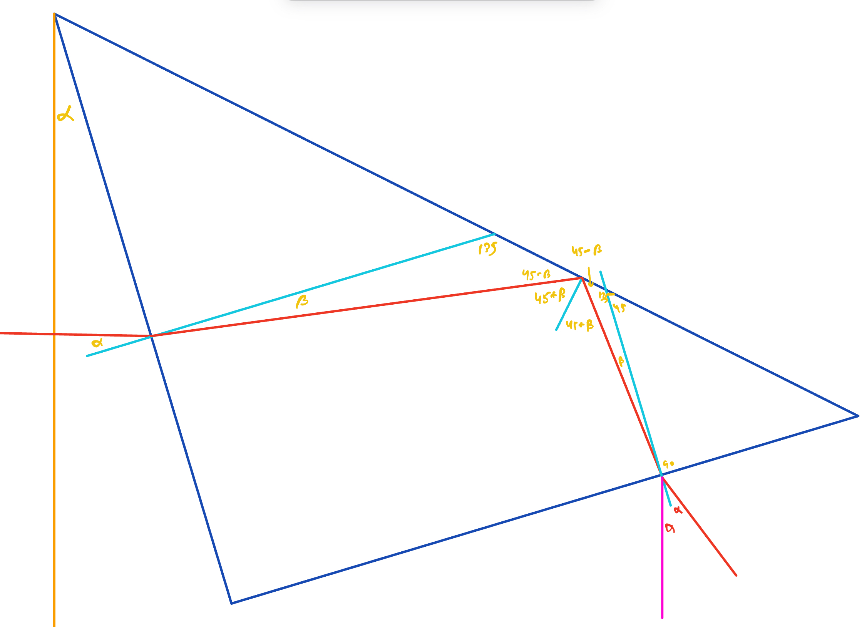

Theoretical Background and calculations
Prism is replacing mirrors for 90 deg rotation by TIR (total internal reflection) of the reflecting face.
For tilt of $α$of the prism from the entrance optical axis
we get $2α$daviation from the exit optical axis
For small incident angle the refraction angle $β$is also the incident angle when exiting the prism so regardless of $n$
( $n>1$) the refraction angle will be $α$ with respect for the exit surface. So $2α$with respect for the exit optical axis
Notes:
For small incident angle the refraction angle $β$is also the incident angle when exiting the prism so regardless of $n$
( $n>1$) the refraction angle will be $α$ with respect for the exit surface. So $2α$with respect for the exit optical axis

Slide 7
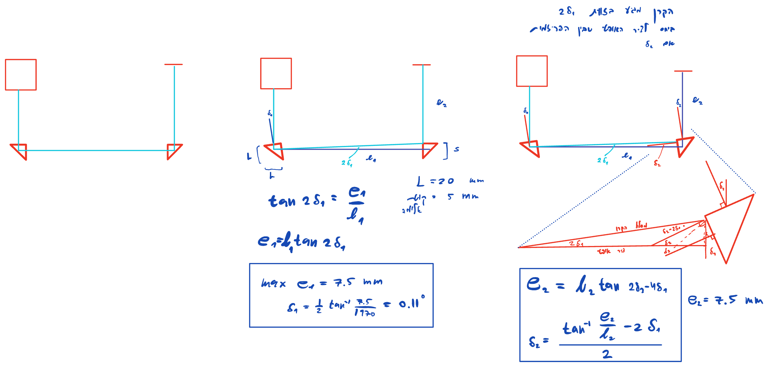
Theoretical Background and calculations

Slide 8

Errors approximation and implications
Tilt angle deviation $δ_{1}{,δ}_{2}$ will introduce incident errors from optical axis $e_{1},e_{2}$
Tilt 1 max error: $e_{1}$
define the max error so the entire beam will land on the 2nd prism
Implication:
beam won’t land in the middle of the prism so monochromatic shift is introduced at the image
Tilt 2 max error: $e_{2}$
define the max error so the entire beam will hit the patterned material.
Implication:
dependent on the $e_{1}$ actual error.
$δ_{1}=\frac{1}{2}\tan^{−1}{\frac{e_{1}}{l_{1}}} ≅1.9 [mrad]$ = $0.11 [deg]$
$δ_{2}=\frac{1}{2}\tan^{−1}{\frac{e_{2}}{l_{2}} }≅0.09 [deg]$

Slide 9
calibration methods

Slide 10
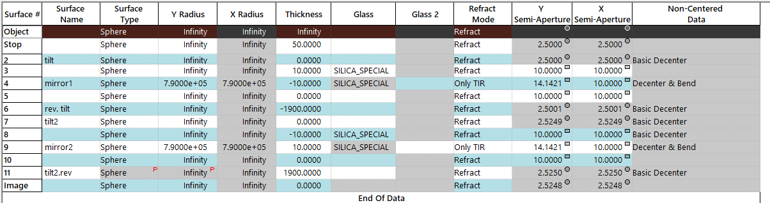
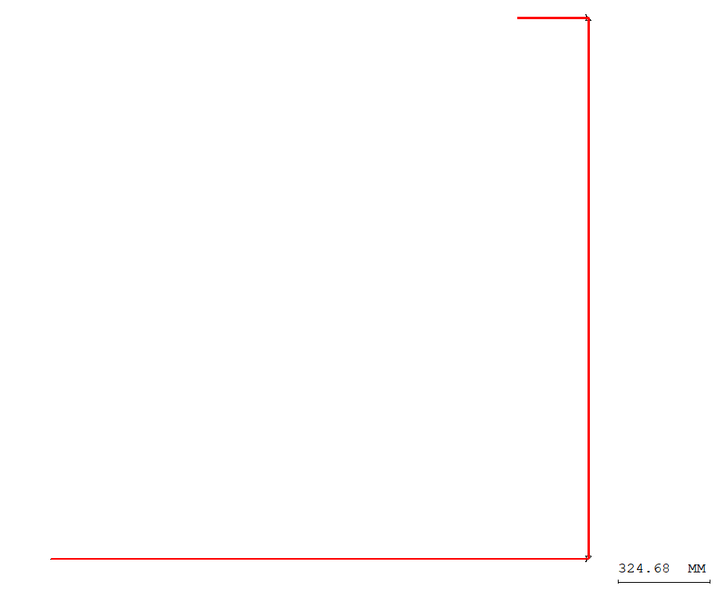
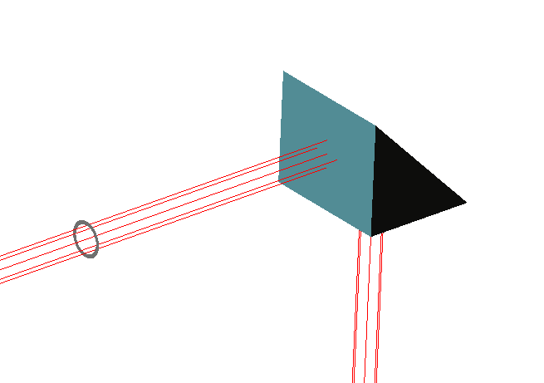
code V
We’ve created a simulation of the system on CodeV, to check its performance and tolerances for the prism positions.
Now we can apply tilt deviation on the prisms, and check the spot diagram

Slide 11
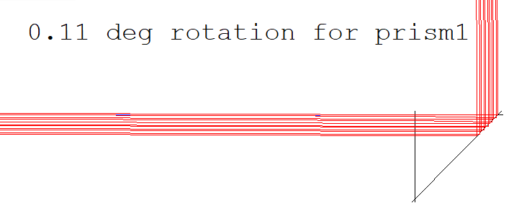
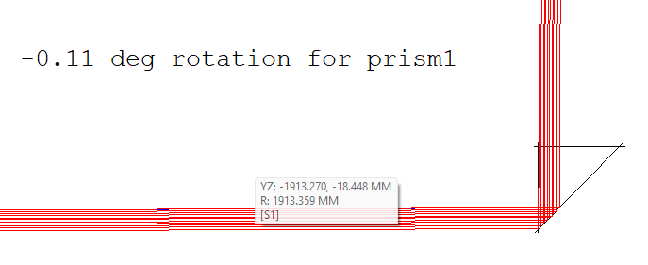
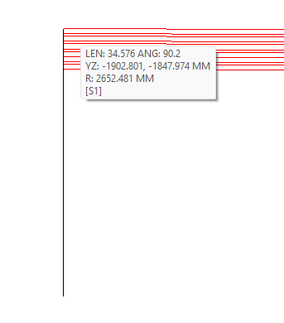

Code V
We got that at deviation range of $∓$ 0.11 deg, the beam incident the prism 2. But at the image plane the beam is deviated from the optical axis by more then 10 mm therefore it will miss the target.
We found that we need max rotation angle 0.055 deg for prism 1.
We were surprised not to see any chromatic aberrations, due the difference in the optical paths inside prism 2.

Slide 12
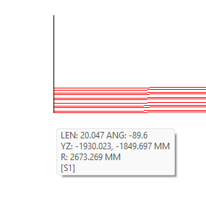

Code V
For prism 2 we can tolerate a deviation range of $∓$ 0.11 deg, and the beam stay inside a diameter of 20 mm at the image plane.
Again no chromatic aberrations.

Slide 13
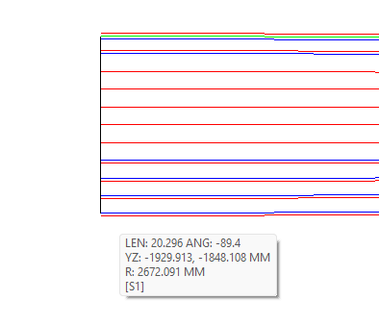
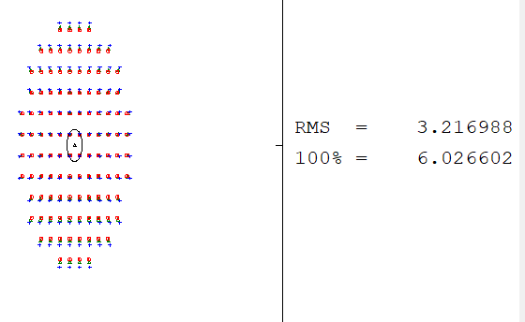

Code V
Now we would like to check the system’s tolerance to the flatness of the reflective surface. The prism’s data sheet specifying flatness of $\frac{λ}{10} at λ=633 nm$
$$⇒ Δ=63.3 nm (Peak-to-valley deviation)$$
That yield a curvature radius of - $R ≈\frac{D^{2}}{8∗Δ}$ = 790000 mm.
Which is very large, applying that on the system make no visible difference, so we’ll reduce that radius to find the tolerance for the flatness.
We found that our limit is R = 10000 mm, in order to keep the beam diameter less than 20 mm. we also noticed a small chromatic aberration (not a problem for our set up)

